Slide 1
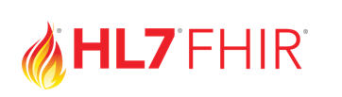
consumer or an authorized caregiver
3rd PARTY APP
Patient
Access API
HEALTH CARE
PAYER

